Slide 1
FACTOR ANALYSIS
ALAN BENNY
MSc. Statistics
Department of Statistics and Data Science
Christ University, Bengaluru.

Slide 2
FACTOR ANALYSIS
It is technique used in multivariate analysis.
Factor analysis also called as Dimension Reduction Analysis
Multivariate Analysis : Multivariate data analysis is a type of statistical analysis that involves more than two variables, resulting in a single outcome. It is particularly useful when researchers or analysts want to understand the relationships between several variables, identify patterns, or make predictions
There are many ways to conduct multivariate analysis such as : Multiple Logistic regression, Factor Analysis, Discriminant Analysis, Cluster Analysis etc….
Notes:
and one of the important assumption of regression model is no multicollinearity.
When there are two or more explanatory variables, the problem of multicollinearity, or linear dependence, is very prominent.

Slide 3
Application Of Multivariate Analysis
Market Research and Consumer Behavior
Finance and Investment
Healthcare and medicine
Environmental Science
Manufacturing and Quality Control

Slide 4
Factor analysis is specially used to condense the data from many variables to just a few variables called super variables or latent variables/Factors.
It reduces dimensions
It is the best way used to simplify the complex data with many variables
Example
Let’s imagine you have a dataset containing data pertaining to a person’s income, education level, and occupation. You might find a high degree of correlation among each of these variables, and thus reduce them to the single factor “socioeconomic status”
You might also have data on how happy they were with customer service, how much they like a certain product, and how likely they are to recommend the product to a friend. Each of these variables could be grouped into the single factor “customer satisfaction”

Slide 5
Purpose Of Factor Analysis
Data Reduction:
It reduces a large number of variables into a smaller set of factors, which simplifies the data without losing much information.
Identifying Structure:
It helps to identify underlying relationships among variables by grouping them into factors.
Simplification:
By reducing the number of variables, factor analysis makes the data easier to understand and interpret.
Identifying Latent Variables:
It reveals unobservable (latent) variables that influence the observed variables.

Slide 6
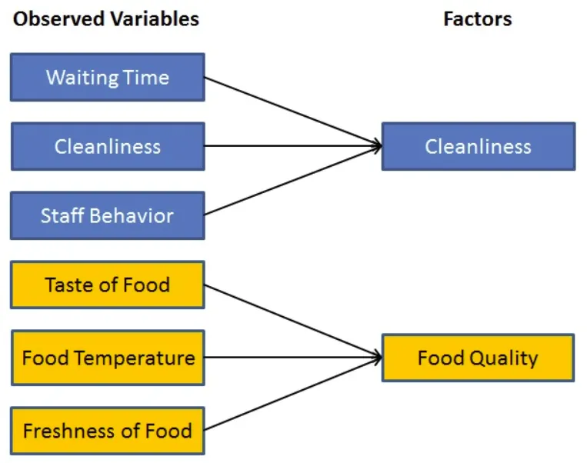
What is Factor Analysis?
Service

Slide 7
Applications of Factor Analysis
Marketing Research
Education
Business
Finance and Economics
Psychology and Social sciences

Slide 8
Advantages and Disadvantages
Advantages
Interpretability
Identification of Variables with Shared Information
Simplifies Complex Data
Data Reduction
Structure Identification

Slide 9
Disadvantages
Subjectivity in Interpretation
Complexity in Deciding Factor Number
Assumptions required
Requires Large sample size
Complexity

Slide 10
Software used for Factor Analysis
SPSS
R
SAS
Stata
MATLAB
Python

Slide 11
Types of Factor Analysis
Exploratory Factor Analysis (EFA)
Principal Component Analysis (PCA)
Common Factor Analysis
Image factoring
Confirmatory Factor Analysis (CFA)
Assumes that the variables are related to specific factors

Slide 12
Factor Loading
Factor loadings describe how much a factor explains each variable.

Slide 13
Factor Analysis Steps
Define the Research Objective : Clearly specify the purpose of the factor analysis. Determine what you aim to achieve or understand through the analysis.
Data Collection : Gather the data on the variables of interest. These variables should be measurable and related to the research objective. Ensure that you have a sufficient sample size for reliable results.
Assess Data Suitability :
Determine the Factor Analysis Technique:
Perform Factor Analysis:
Interpret and Validate the Factors:

Slide 14
Factor Analysis Using Python
https://colab.research.google.com/drive/1e9NJoMyy21fqPoVkvVvY3saJZDpmtufL#scrollTo=evxBLbEX_FLc

Slide 15
REFERENCES
https://www.analyticssteps.com/blogs/what-multivariate-data-analysis#google_vignette
https://www.analyticssteps.com/blogs/factor-analysis-types-applications
https://www.toppr.com/guides/algebra/factorisation/factor-analysis/
https://researchmethod.net/factor-analysis/

Slide 16
THANK YOU

